Slide 1
Summary (Rubisco)
CO2 is fixated by Rubisco
Rubisco catalyzes both oxygenation and carboxylation of ribulose-1,5-bisphosphate
Carboxylation → 2 phosphoglycerate → calvin cycle (photosynthesis)
Oxygenation → phosphoglycerate and phosphoglycolate → phosphoglycolate recycled through photorespiration
balance between both activities depends on O₂/CO₂ ratio in leaves

Slide 2
Summary (Photorespiration)
Negative impact on plant growth
Recovery of carbon from phosphoglycolate
Removal of inhibitors of photosynthesis
Photorespiration mutants cannot grow at ambient CO2 concentration

Slide 3
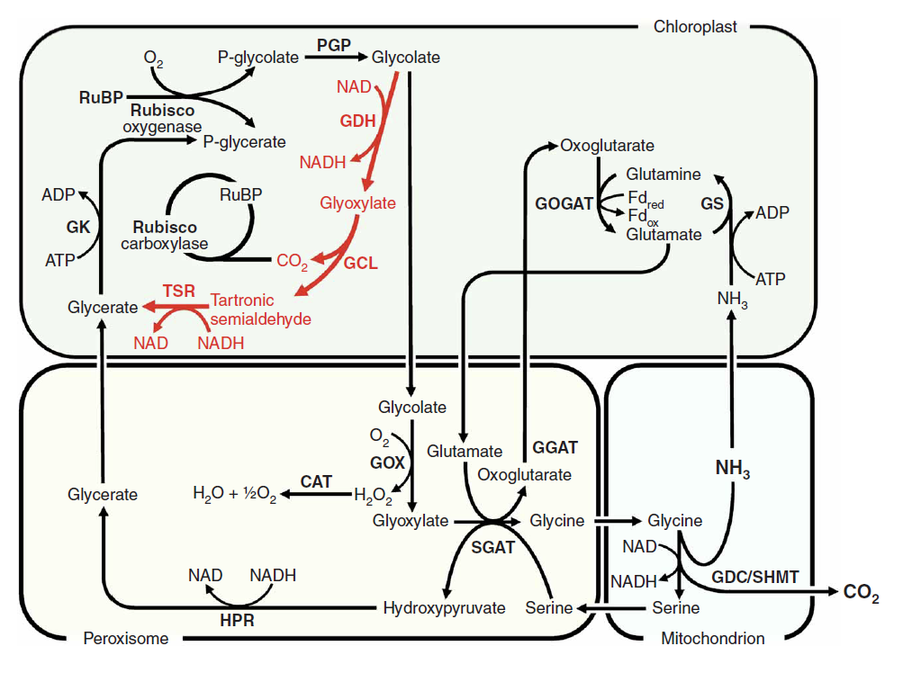
Summary(Methods)
Creation of pathway requires three plasmid
One encodes both GDH subunits D and E
One encodes subunit F of GDH
One encodes both GCL and TSR
Experiments were conducted with 3 kinds of plants. WT-, DEF- and GT-DEF-plants.

Slide 4
Summary (Bypass)
Reduction of photorespiratory losses by this catabolic pathway
Gly/Ser ratio
Increased by a factor of 10 for WT
PIB as indicator of CO2 release
~30% compared to the wild type
Enhanced CO2 release from glycolate in chloroplast extracts
Improved photosynthetic performance
More biomass production in DEF and GT-DEF plants
Notes:
Step-wise nuclear transformation and targeting
No homozygous lines

